Slide 1
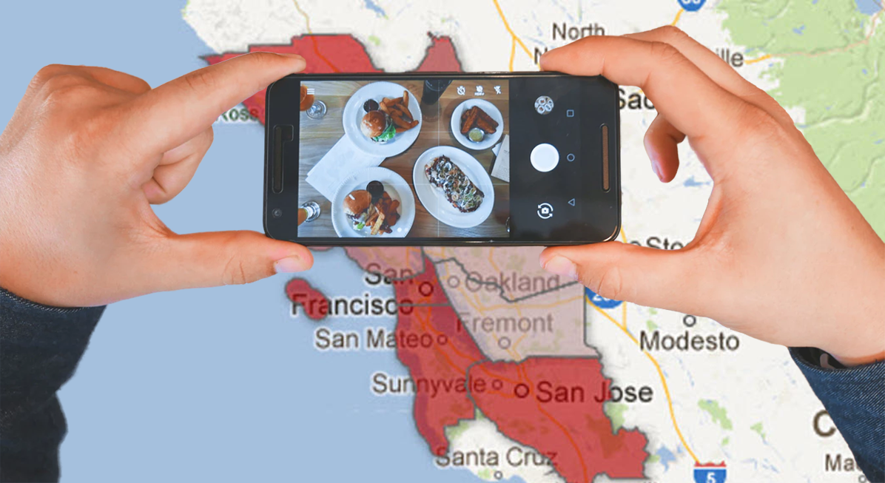
All food in the hood
A Yelp API comparison study of eateries and regions in the Bay Area
Phillip Choi ∙ Loba Quasem ∙ Carly Russell ∙ Natalie……………..∙

Slide 2
Presentation menu A Project in four courses
Cocktails List
Click item for more details
Dessert
Introduction
3
Hypothesis
4
Project Scope
5
Results
12
Graphs
13
Api-tizer
Side Items
Yelp API
6
Areas to Improve 13
Assumptions
7
Modeling
8
Future Exploration 14
Entrée
Total Bill
Data Collection 9
Implementation 15
Data Prep 10
Tips for Repeat Studies 16
Conclusion 17
Analysis 11

Slide 3
Introduction
The Bay Area’s innovative nature and diversity nourishes a hub of unique eats and is home to some of the top restaurants in the world
Problem Statement
Evaluating Bay regions for a foodie to live or visit
Challenges
Thousands of Restaurants
Vast Area
Modeling

Slide 4
Hypothesis
Dense urban areas have:
More top-rated restaurants
More cuisine types
SF, SJ, Oakland

Slide 5
Project scope
Grade & Compare 9 Bay Counties
Yelp API as sole resource
Defining Bay Area
Defining restaurant
Defining top-rated
Defining categories

Slide 6
Yelp api
Applicable query parameters:
Term search
Location search
Geocoordinates
Search radius
Sort by Yelp rating
Each query returns max 1k results

Slide 7
Assumptions
Foodie’s preferences
Yelp is sole reference
Yelp data complete and error-free
All reviews unbiased and standardized
Ratings = Quality of Food

Slide 8
Modeling
For each county, evaluate using formula:
(Total Restaurants) + (Total Unique Categories) + ( Total Rated 3.5+) +
(Total Unique Categories in Set of Restaurants Rated 3.5+) + (Avg Overall Rating)
Able to scale up or down

Slide 9
Data collection
Data to Gather:
Bay Cities with Geocoordinates
Yelp API
Total Counts
Binned Ratings
Category Counts
Problematic API
Search parameters not specific
Duplicate data
1k result limit per query
Over half of queries have >1k
Solution
Trial and Error
Search by Geocoordinates
Determining Grid & Parameters
Result
Only 2 queries >1k

Slide 10
Data prep
Raw Data:
Duplicate entries
Returned locations not in Bay
Unnecessary categories
Process:
Check Yelp ID for duplicates
Delete rows with unexpected zip
Loop to remove irrelevant categories
Output:
Full set of valid restaurants in Bay
Merge with county using zipcode

Slide 11
Analysis
Full Bay Area Dataset:
Total Count, Category Dist., Ratings Dist., Avg. Rating
County scale:
Total Count, Category Distribution, Ratings Distribution, Avg. Rating

Slide 12
results

Slide 13
graphs

Slide 14
Areas to improve
Verifying Data
Supplement with Additional Sources
Research Preference Factors
Tweak Formula

Slide 15
Future Exploration
Compare on Local Level
Combine with Alternate Sources
Compare Foodie Hotspots to Local Rent Prices
Expand Outside Food, eg. Clubs, Bars, Golf
Study Other Major Cities

Slide 16
Implementation

Slide 17
Tips for repeat studies

Slide 18
conclusion

